Slide 1
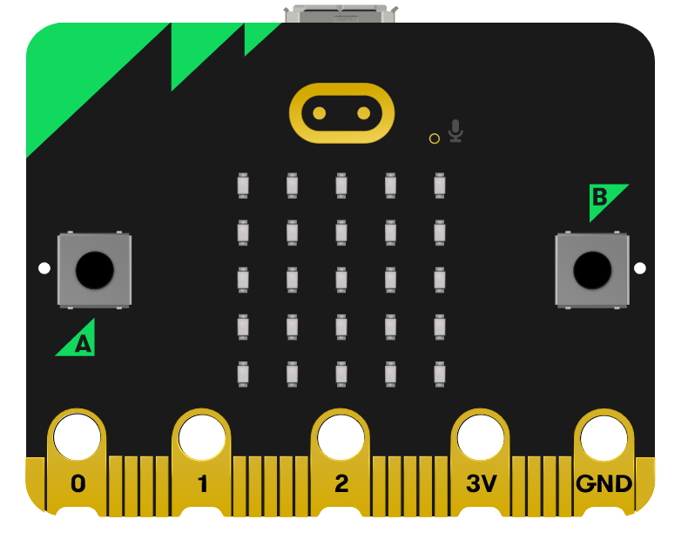
Fitness Frenzy.
Design a Pedometer using a micro:bit
Digital Schoolhouse, 18a Blackbull Yard, 24-28 Hatton Wall, London EC1N 8JH.
Copyright © 2023 Digital Schoolhouse. All rights reserved.

Slide 2
Challenge: Today we will.
Design and build a pedometer using the accelerometer on a micro:bit.
Add count-controlled loops and variables to our code.
Use micro:bit LEDs and inputs to design our own exercises.

Slide 3
What is a pedometer?
Digital Schoolhouse, 18a Blackbull Yard, 24-28 Hatton Wall, London EC1N 8JH.
Copyright © 2023 Digital Schoolhouse. All rights reserved.

Slide 4
What is a Pedometer?
In groups of 4 research what a pedometer is.
Be ready to present your findings to the class.
Find out:
What it does i.e. special features?
Are there different types?
What do they cost?
Any other fun facts about them…

Slide 5
What did we find out?

Slide 6
What is a micro:bit?
Digital Schoolhouse, 18a Blackbull Yard, 24-28 Hatton Wall, London EC1N 8JH.
Copyright © 2023 Digital Schoolhouse. All rights reserved.

Slide 7
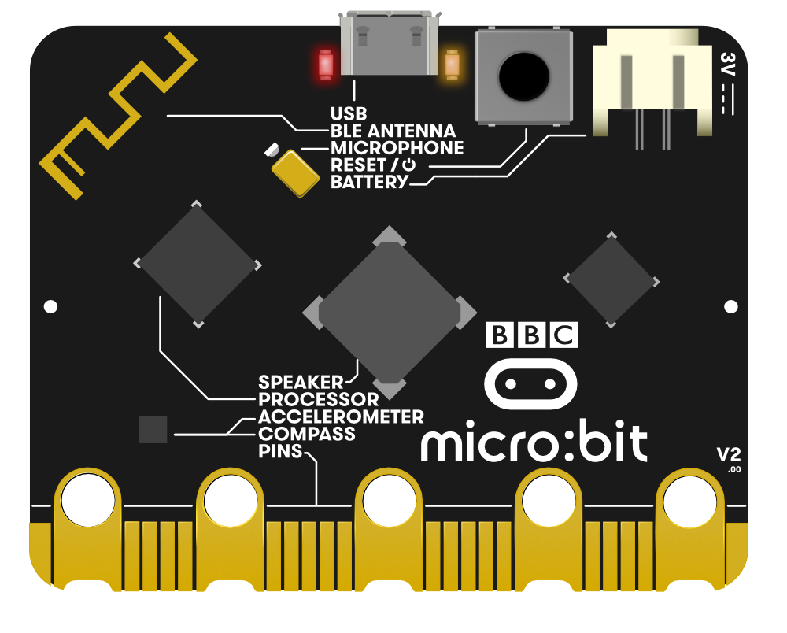
What is a micro:bit?
The micro:bit is a tiny computer.
You can write programs for the micro:bit on your computer and then transfer them to the micro:bit to be run.

Slide 9
Tracing Code - Predict what will this code do.
What will each block do?
What will happen on the start?
When you press button A, what will display on the micro:bit?

Slide 10
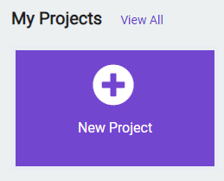
Let’s run the code. Go to makecode.microbit.org Choose ‘New Project’ and give it a name…
Test out your prediction.

Slide 11
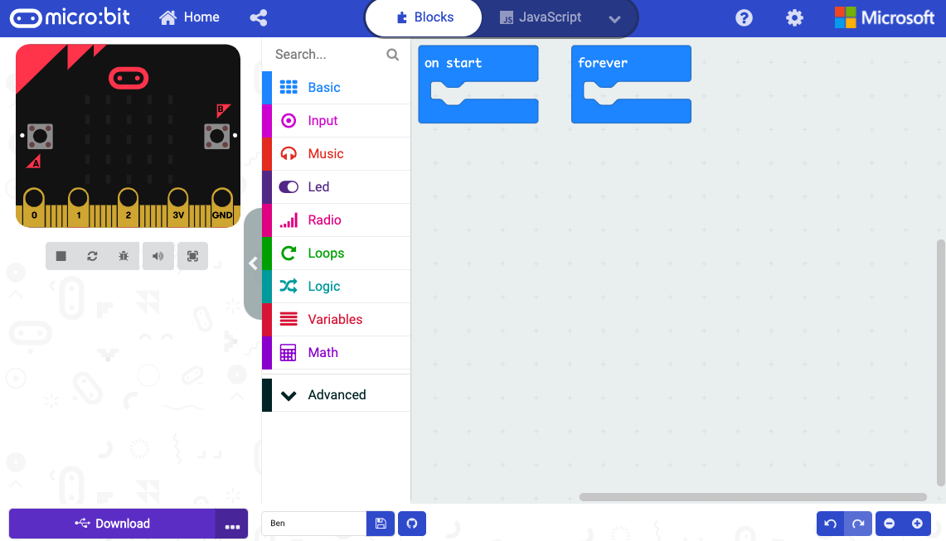
The micro:bit programming environment.
Programming area – place your blocks here
Emulator: simulation of a physical micro:bit where you can test code
Programming blocks – coloured blocks similar to Scratch

Slide 12
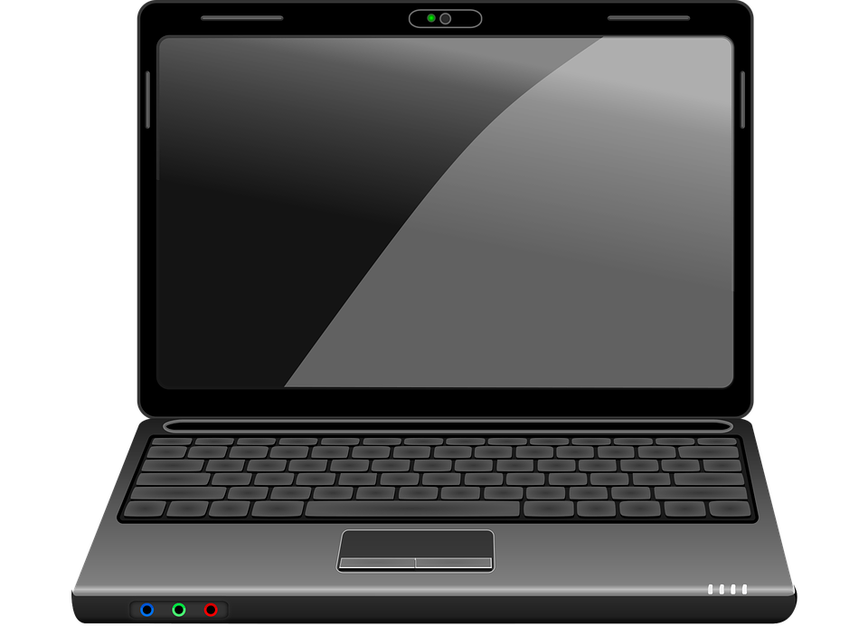
Running code on a micro:bit.
Connect the micro:bit to your computer using the USB cable.
Name your project before you download.

Slide 13
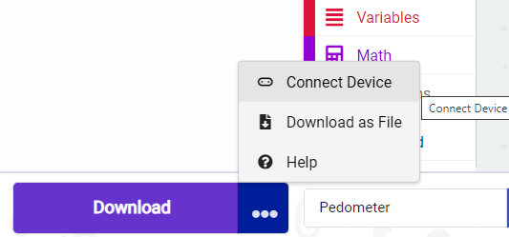
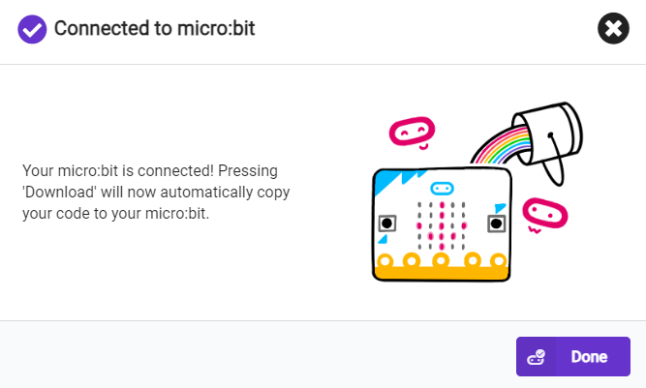
Click on the three dots next to download.
Choose connect device.
Click next.
Choose pair.
Click on your Micro:bit and choose connect.
Your Micro:bit is connected to download your code!

Slide 14
What did you find out?
Were you right?
Did anything surprise you?
What else did you find out?

Slide 15
Design your pedometer.
Digital Schoolhouse, 18a Blackbull Yard, 24-28 Hatton Wall, London EC1N 8JH.
Copyright © 2023 Digital Schoolhouse. All rights reserved.

Slide 16
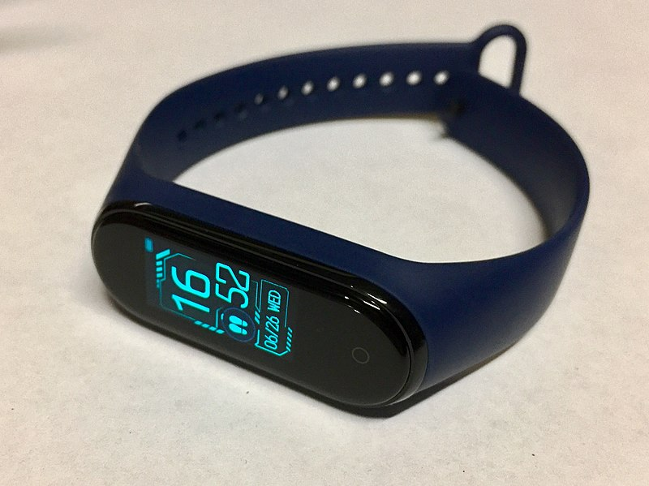
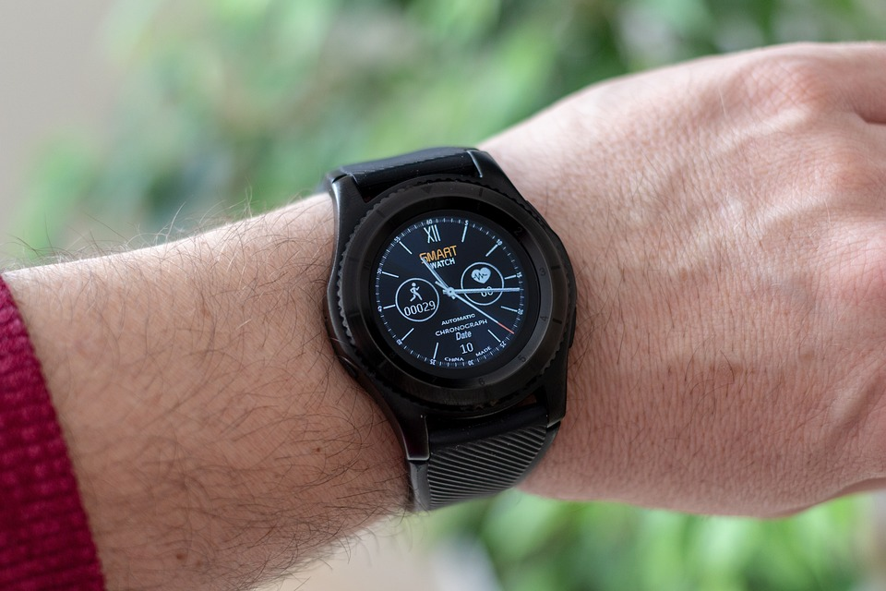
Pedometers - Let’s recap.
Step counter - helps us exercise and tell the time!
Can also be heart monitor and many more exciting things.
It is portable and counts steps by detecting the motion of our hands or hips – accelerometer.

Slide 17
To create your pedometer you will need to use a variable.
A variable is a place inside the micro:bit’s memory where data can be stored and changed while a program is running. The variable is given a name, so you can use the data it contains in your programming.
What do you need a variable for?
What will you name your variable?

Slide 18
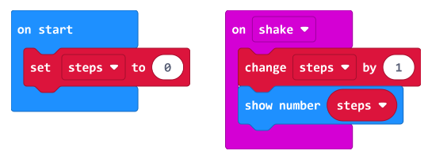
Pedometer Code: Adding a variable to your code.
What else could we add?

Slide 19
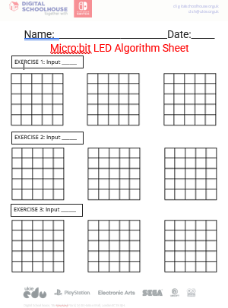
Using the Micro:bit inputs.
Add exercises using the A, B and A + B inputs.
Write an algorithm for your exercise first then code it.

Slide 20
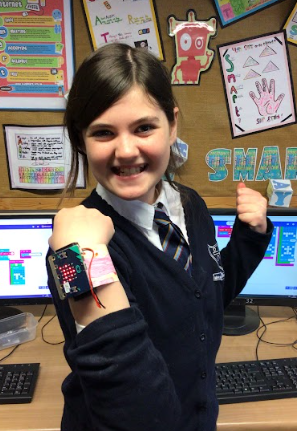
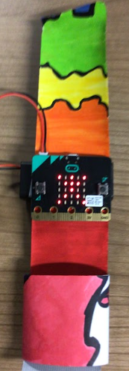
Pedometers - Design your strap.
Simple Strap:
Strip of Paper or Card
Colour with felt tips
Attach to duct tape

Slide 21
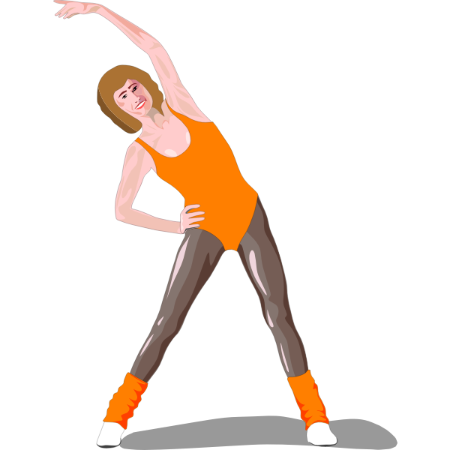
Test your design: Will it work?
Try out your micro:bit - do exercises for 10 mins.
Use your own and other’s pedometers.
Did it record your steps?
Do you feel fitter?

Slide 22
Challenge: How did you do?
To design and build a pedometer using the accelerometer on a micro:bit.
To add count-controlled loops and variables to our code.
To use micro:bit LEDs and inputs to design our own exercises.

Slide 23
Fitness Frenzy.
Design a Pedometer using a micro:bit
Digital Schoolhouse, 18a Blackbull Yard, 24-28 Hatton Wall, London EC1N 8JH.
Copyright © 2023 Digital Schoolhouse. All rights reserved.

Slide 24
Optional unplugged activity: ASCII Character set
Char | Binary code | Char | Binary code | Char | Binary code
A | 01000001 | J | 01001010 | S | 01010011
B | 01000010 | K | 01001011 | T | 01010100
C | 01000011 | L | 01001100 | U | 01010101
D | 01000100 | M | 01001101 | V | 01010110
E | 01000101 | N | 01001110 | W | 01010111
F | 01000110 | O | 01001111 | X | 01011000
G | 01000111 | P | 01010000 | Y | 01011001
H | 01001000 | Q | 01010001 | Z | 01011010
I | 01001001 | R | 01010010

